Slide 1
Brain Tumor Patient Analysis Dashoard
Patient Distribution, Treatment Coverage & Follow-up Insights
Domain: Healthcare Analytics
Tool :Power BI
Dataset: Brain Tumor Patient Records
Presented by: Ruchi Rajput

Slide 2
Agenda
Objective
KPIs Used
Key Insights
Recommendations
BRD-Summarized
Final Report Summary

Slide 3
Objective:-
• Analyze brain tumor patient data
• Understand tumor distribution by age, gender, type, and stage
• Identify patterns by age, gender, tumor type & stage
• Evaluate treatment impact on survival rate
• Support medical decision-making using insights

Slide 4
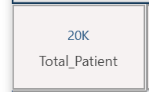
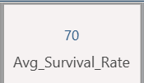
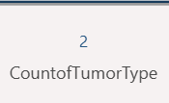
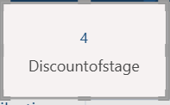
KPIs Used:-
• Total Patients
• Average Survival Rate
• Count of Tumor Type
• Count of Tumor Stage

Slide 5
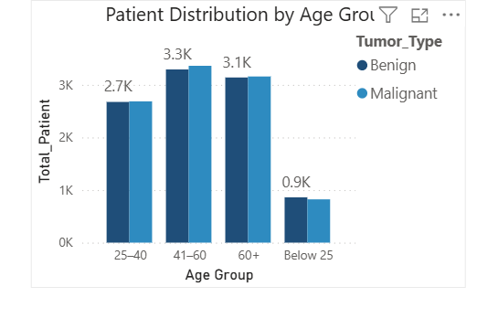
Key Insights:-
1.Patient Distribution by Age Group
“The majority of brain tumor patients fall in the 41–60 age group, indicating middle-aged adults represent the most affected population segment in this dataset.”

Slide 6
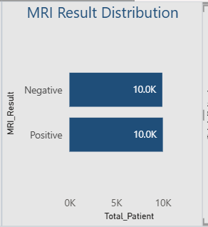
2.MRI Result Distribution
“This chart shows the distribution of MRI diagnostic results among patients, helping identify the prevalence of abnormal findings and potential diagnostic burden.”

Slide 7
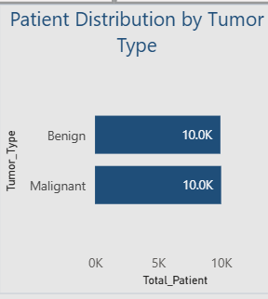
3.Patient Distribution by Tumor Type
“This visual highlights the most prevalent tumor types among patients, helping identify areas that may require greater clinical focus and resource allocation.”

Slide 8
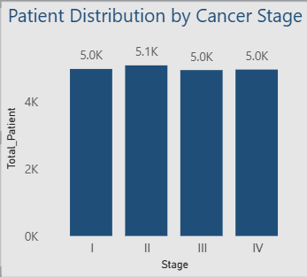
4. Patient Distribution by Cancer Stage
“Most patients in the dataset are diagnosed at Stage 2, indicating that a significant portion of cases are identified at an intermediate stage of disease progression.”

Slide 9
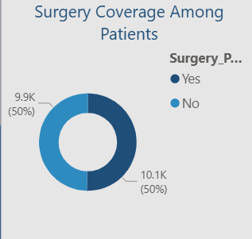
5.Surgery Coverage Among Patients
“A majority of patients in the dataset have undergone surgical treatment, indicating surgery is a commonly adopted intervention for brain tumor cases.

Slide 10
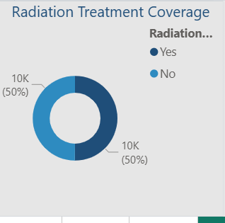
6. Radiation Treatment Coverage
“Radiation therapy has been administered to a majority of patients, indicating it is a widely used treatment modality alongside surgery.”

Slide 11
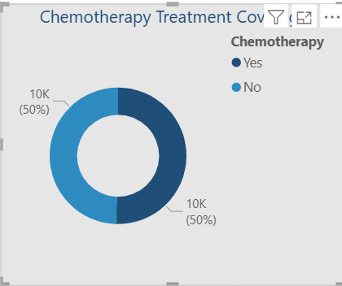
7.Chemotherapy Treatment Coverage
“Chemotherapy usage is evenly distributed among patients, suggesting it is applied selectively based on patient condition rather than as a standard treatment for all cases.”

Slide 12
Recommendations:-
• Early-stage detection programs
• Combine surgery with chemotherapy for malignant cases
• Regular MRI scans for high-risk patients
• Focused monitoring for Stage III & IV patients
• Age-based preventive screening

Slide 13
Business Requirement Document (BRD)
Business Goal:
Improve clinical insight & treatment planning
Stakeholders:
Doctors, Hospital Admin, Analysts
KPIs:
Survival Rate, Tumor Type, Stage, Treatment

Slide 14
Final Report Summary
This Power BI dashboard provides a comprehensive view of
brain tumor patient data. It highlights critical trends in
tumor stages, treatment effectiveness, and survival outcomes.
The dashboard enables data-driven healthcare decisions.

Slide 15
Thank You

